Slide 1
HR MANAGEMENT
MINI PROJECT
Department of MCA, MES College of Engineering , Kuttippuram
^{26th} OCTOBER 2023
PREPARED BY
PAVITHRA C R (MES22MCA-2040)

Slide 2
GUIDED BY
PRIYA J D
ASSISTANT PROFESSOR
MASTER OF COMPUTER APPLICATIONS
MES COLLEGE OF ENGINEERING , KUTTIPPURAM

Slide 3
Introduction
Modules
Product Backlog
Project Plan
Sprint
. Developing Environment . DFD
CONTENTS

Slide 4
INTRODUCTION
This project is aimed at developing a web-based Recruitment Process System by the HR Group for a company. Some features of this system will be creating vacancies, storing Applicants data, Online Examination process initiation, Scheduling Exams and Interviews, Storing Exam and Interview results for the applicant and finally Hiring the applicants. This project consist of three modules -the Admin module, HR module, candidate module.
the key objectives for developing such a system Online Job Postings: Allow HR to create and manage job postings online, making it easier to reach a wider pool of potential candidates. Efficiency and Time Savings: The primary objective is to streamline and automate the recruitment process, reducing the time and effort required for tasks like creating vacancies, storing applicant data, scheduling interviews, and conducting exams. Online Examination Process: Implement an online examination module to assess the skills and qualifications of applicants.

Slide 5
MODULES
ADMIN
LOGIN
MANAGE HR
VACCANCY VIEW
VACCANCY APPROVE
VIEW SHORTLISTED CANDIDATES
VIEW SELECTED CANDIDATES
HR
LOGIN
VACCANCY MANAGE
APPLICATION STATUS VIEW
MANAGE TEST QUESTIONS
SORT CLIENTS & SEND INTERVIEW DETAILS
UPDATE INTERVIEW SCORE
UPDATE SELECTION RESULT

Slide 6
CLIENT
LOGIN
REGISTER
VIEW VACCANCY
APPLY FOR POST
ATTEND TEST
VIEW RESULT
VIEW INTERVIEW DATE
VIEW SELECTION NOTIFICATION

Slide 7
PRODUCT BACKLOG
ID | PRIORITY | SIZE (Hours) | SPRINT | STATUS | NAME
1 | Medium | 5 | 1 | Progressing | Registration
2 | Medium | 5 |  | Progressing | Login
3 | High | 10 | 2 | Planned | Table Design
4 | High | 15 |  | Planned | Other Coding
5 | Medium | 10 | 3 | Planned | Testing data
6 | High | 5 |  | Planned | Output generation

Slide 8
PROJECT PLAN
ID | Sprint | Start Date | End Date | Day | Status
1 | Sprint 1 | 15/09/2023 | 12/10/2023 | 13 | Planned
2 | Sprint 2 | 13/10/2023 | 03/11/2023 | 15 | Planned
3 | Sprint 3 | 08/11/2023 | 30/11/2023 | 15 | Planned

Slide 9
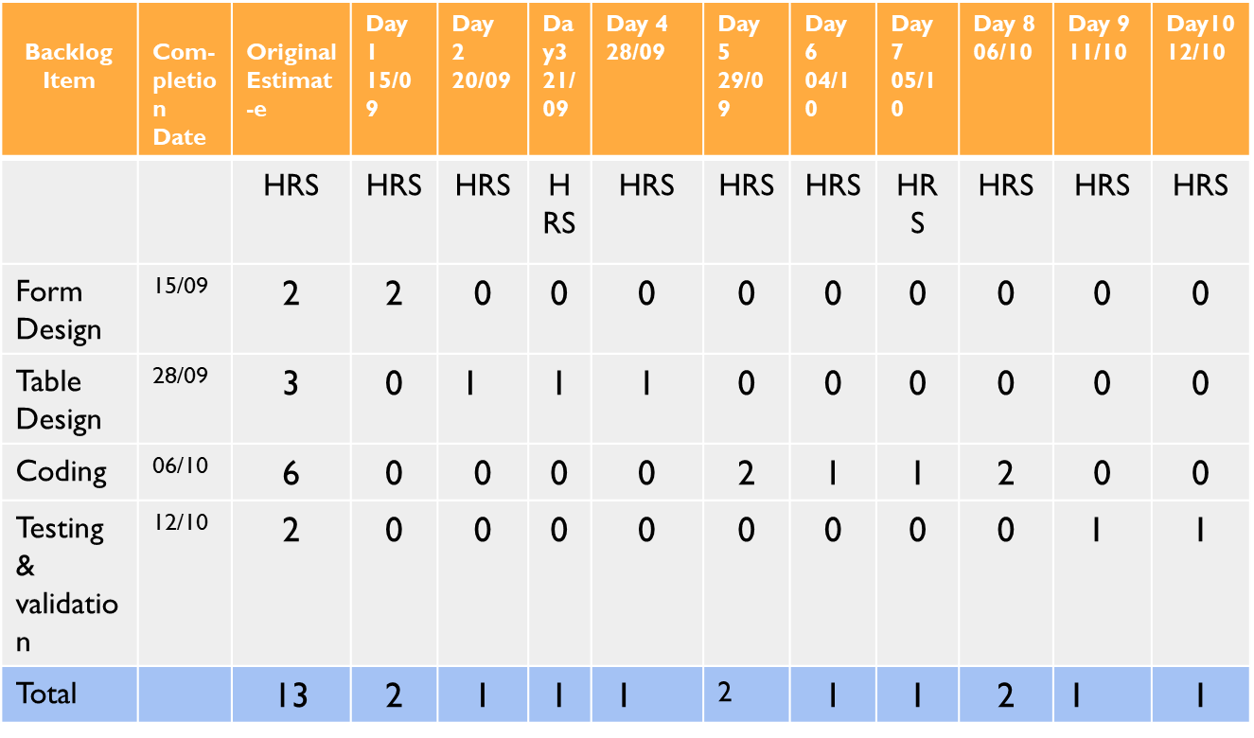
SPRINT PLAN 1

Slide 10
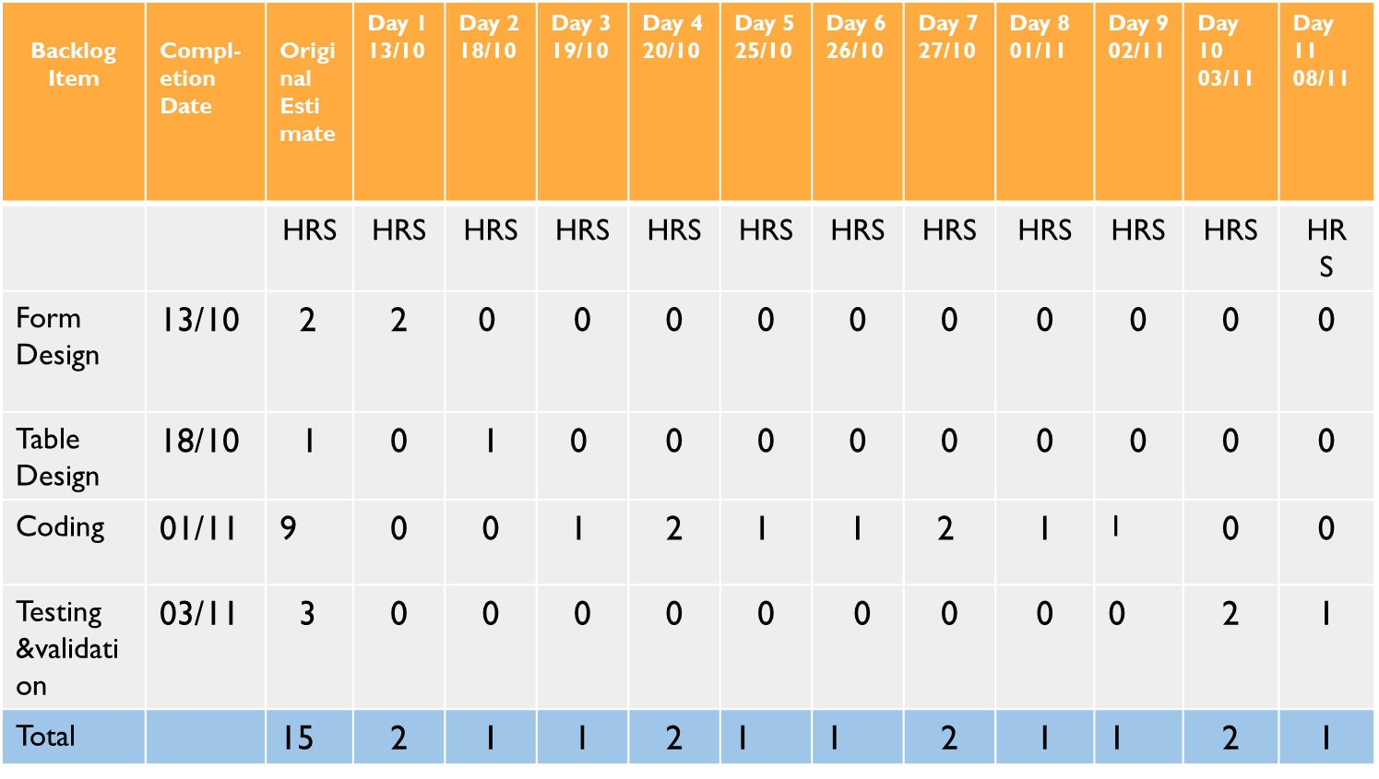
SPRINT PLAN 2

Slide 11
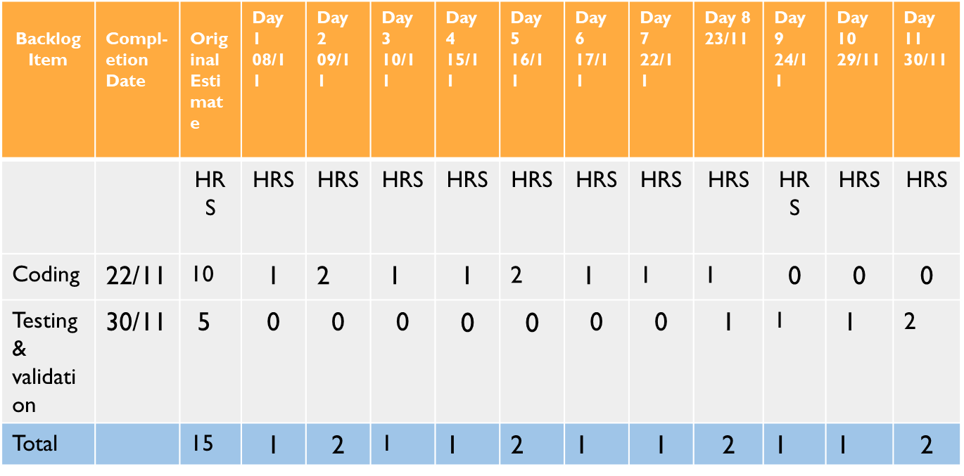
SPRINT PLAN 3

Slide 12
DEVELOPMENT ENVIRONMENT
SOFTWARE SPECIFICATION
Operating System
Frond End
Coding language
Framework
Backend
IDE
Browser
: Windows 8 or above
: HTML,CSS and Javascript
:Python
:Django
:MySQL
: Pycharm community , Android studio :Internet Explorer / Chrome / FireFox
HARDWARE SPECIFICATION
Processor
Hard Disk
RAM
: Intel Pentium IV or above
:40GB and above
:4GB or Above

Slide 13
DFD

Slide 14
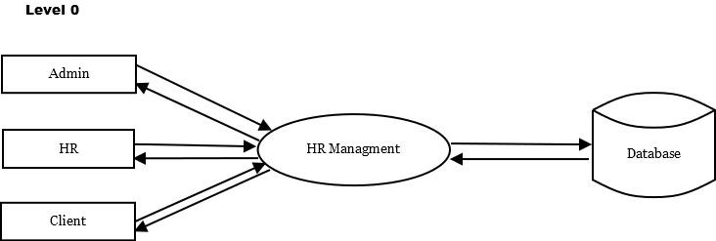
request
response
request
request
response
response
request
response

Slide 15
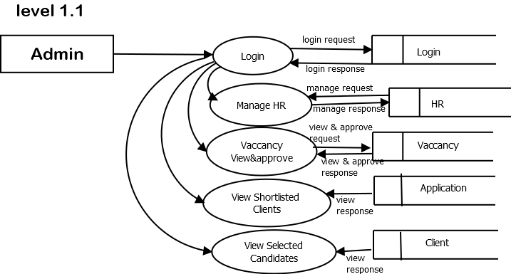

Slide 16
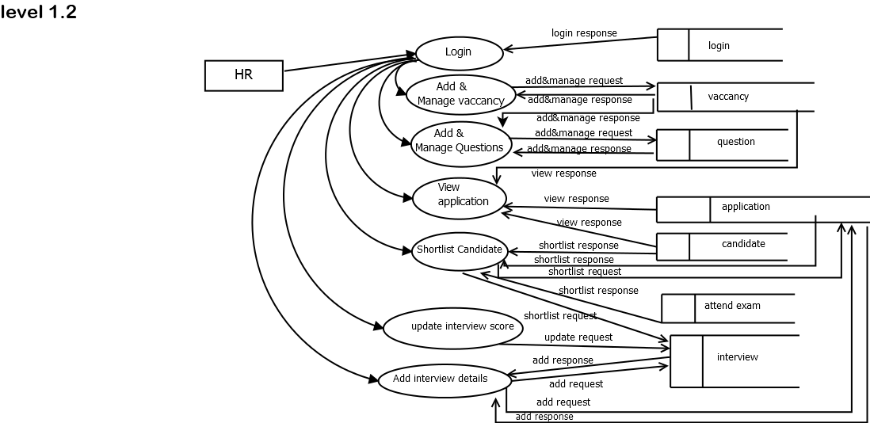

Slide 17
